Slide 1
Use of Infrastructure IoT in wheat Agriculture in Nepal

Slide 2
Agenda
It show about the IoT system in the agriculture.
It talk about the soil, mositure, climate climate, etc.
Its main focus on Monitoring soil on the article.
The article tell us about the agriculture which is current situation in the Nepal.
It also talk about the how much IoT system is used in Nepal during current situation.
Writer also talk about the problem and solution of the current agriculture sector.

Slide 3
Introduction
The art and science of cultivating the soil, growing crops, and raising livestock is known as agriculture.
IoT has been defined as a system of interrelated computing devices, mechanical and digital machines, objects, animals, or people that are provided with unique identifiers and the ability to transfer data over a network without requiring human-to-human or human-to-computer interaction.
IoT technology is opening up new promising technological paths and pushing the future of agriculture to the next level.
IoT technology is used to provide the agriculture into new step or upgrade the step and provide the new technology system and technique.

Slide 4
Purpose
To make fertilize the soil by using IoT system.
To make people give more knowledge about the new system of IoT which is used in agriculture.
To make people to use new machine or technology in the agriculture to make their agriculture better.
To make more crops through the agriculture by using IoT system.
To give knowledge about the other country technique of their agriculture to know the proper way to used.

Slide 5
Methodology
I think writer want to use advance IoT system in the agriculture which make a better for the farmer.
The article also has depth and meaningful information where writer show the information through the IT sector also.
The main factor of the agriculture is soil, mositure, climate change, etc. which is directly hammpered to the agriculture.
The article has talk all about the beginning phase in the agriculture that I will be processed with strong and meaningful way to solve all the problem and make even better to the farmer.

Slide 6
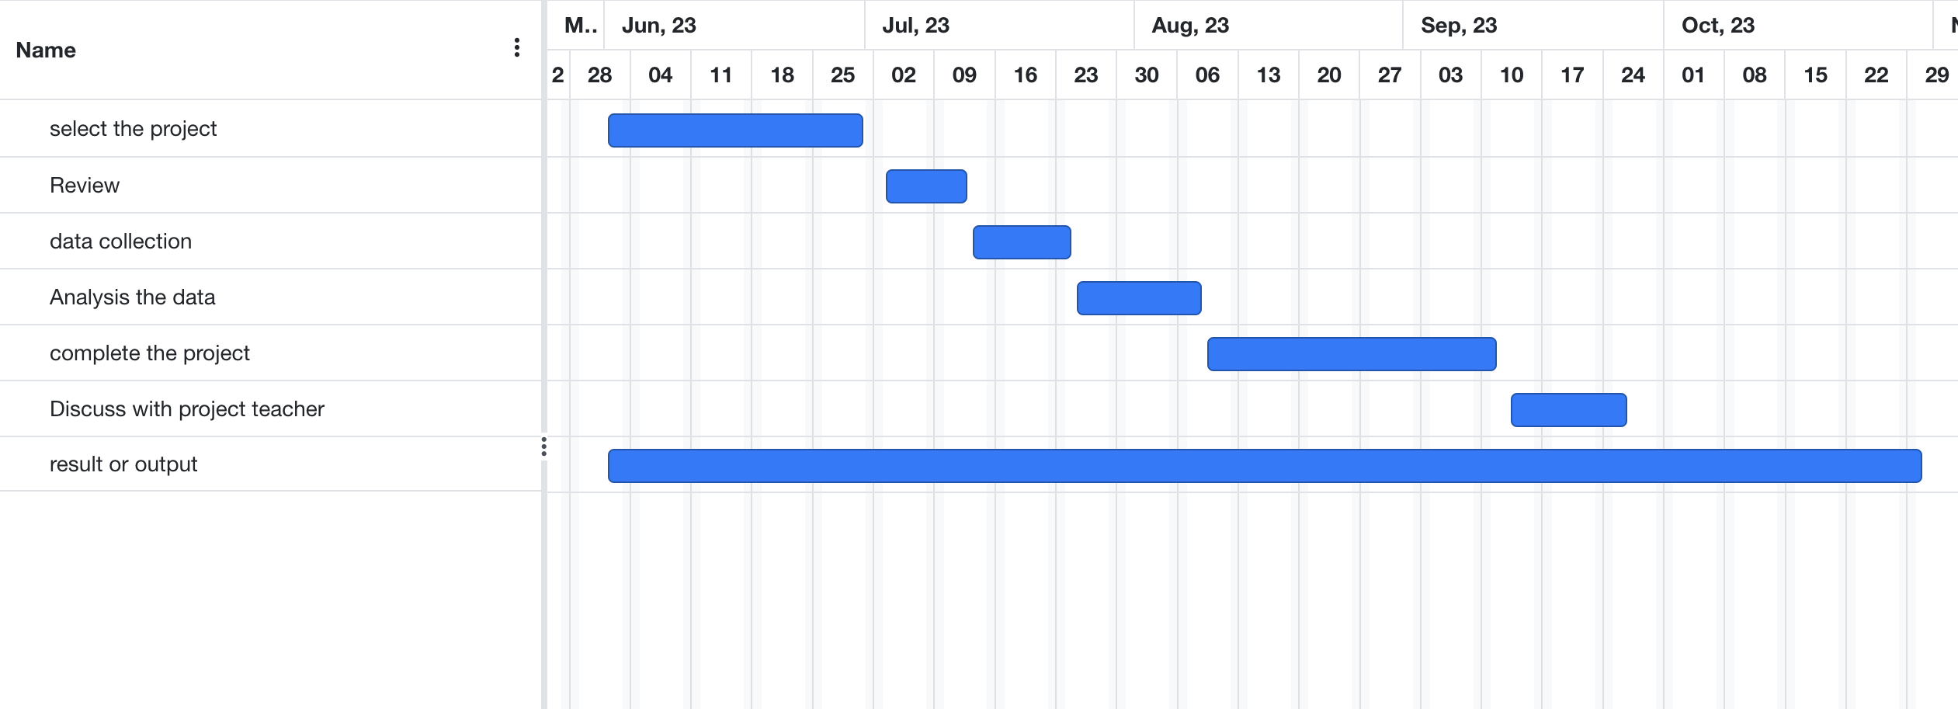
Schedule

Slide 7
Conclusion
According to a review of the literature, there is a lot of effort being done to create IoT technology, which can be applied to boost plant and livestock productivity and operational effectiveness.
According to a review of the literature, there is a lot of effort being done to create IoT technology, which can be applied to boost plant and livestock productivity and operational effectiveness.
It show that IoT system will be the future of the agriculture sector in each and every step.
The writer also show that the important factor of the agriculture is the soil, moisture, climate change and others.

Slide 8
References
https://www.intechopen.com/chapters/82091
https://fardapaper.ir/mohavaha/uploads/2019/05/Fardapaper-An-Overview-of-Internet-of-Things-IoT-and-Data-Analytics-in-Agriculture-Benefits-and-Challenges.pdf
https://education.nationalgeographic.org/resource/agriculture

